Slide 1


District Counselor Meeting
Inspire
Inspire
May 30, 2024

Slide 2


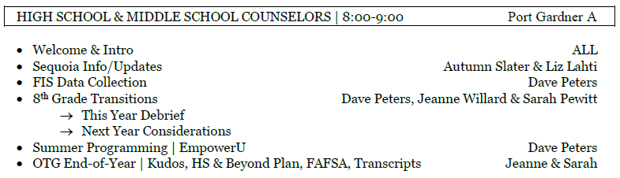
Today’s Agenda

Slide 3

Sequoia Info & Updates
Autum Slater
&
Liz Lahti

Slide 4

Forefront End-of-Year Data Collection | HS
SURVEY | Student Support Services Q’s | School Q’s
Semester Report | 1-9, 10-12, 14-17 | 10-14, 16-22
FIS End-of-year | 1-2, 4-9, 11-13, 14.a&b | 3, 9-11, 14.c&d, 15-18

Slide 5



8th – HS Transitions

Slide 6
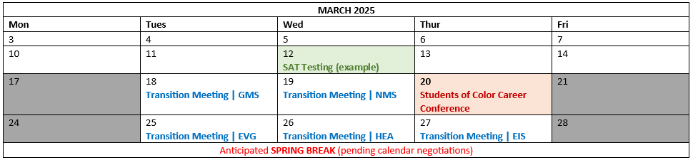

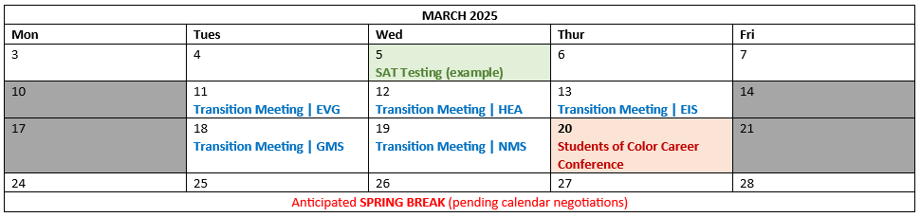
8th – HS Transitions | 2024-25

Slide 7


Summer Programming | EmpowerU
Tanys Aris @ CHS

Slide 8
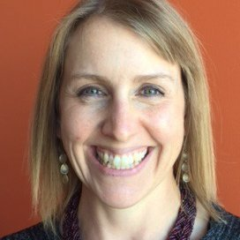
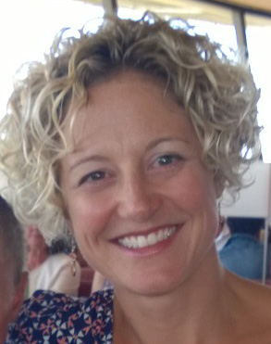
OTG End-of-Year
Jeanne Willard
Sarah Pewitt

Slide 9
District Counselor Meeting
Inspire
Inspire
May 30, 2024

Slide 10
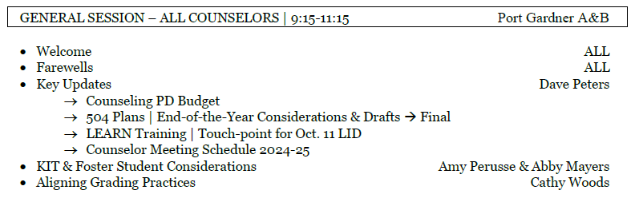
Today’s Agenda

Slide 11





Happy Retirement!
Happy Retirement!
11

Slide 12

Thanks for Everything!
Lauren Carlos
Emily Dunham
Chey Kawaihae

Slide 13

Learning Improvement Day | October 11, 2024
Purpose
Counselor Role
Group Size
Presentation Format
Level of Detail
13
13

Slide 14
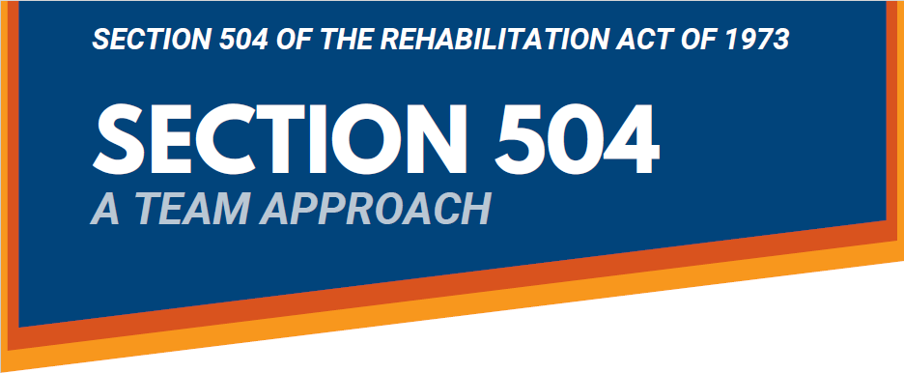
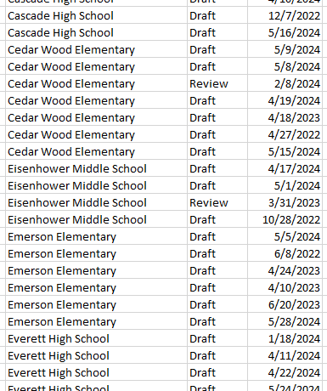

504 Plans | End-of-the-Year Considerations
Before the end of the school year, ensure that each 504 form for your students is set to
(or delete if never used)
14
14

Slide 15




District Counselor Meetings | 2024-25
Proposed Counselor Meeting Dates
THURSDAYS
Fall Semester | Spring Semester
★ September 26 | ★ February 13 or 20
★ October 31 | (no March meeting due to pre-reg)
★ December 5 | ★ April 17
★ January 16 | ★ May 29
15
15

Slide 16

KIT & Foster Student Considerations
Amy Perusse
&
Abby Mayers
16
16

Slide 17
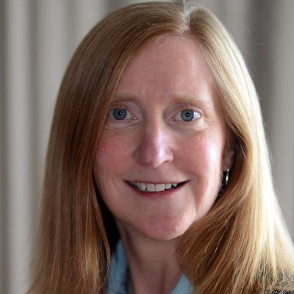
Aligning Grading Practices
Cathy Woods
17
17

Slide 18
District Counselor Meeting
Inspire
Inspire
May 30, 2024

Slide 19
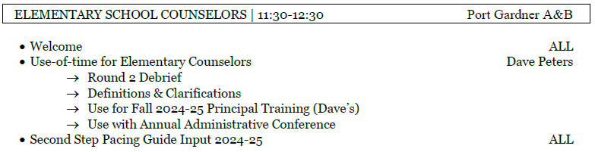
Today’s Agenda

Slide 20
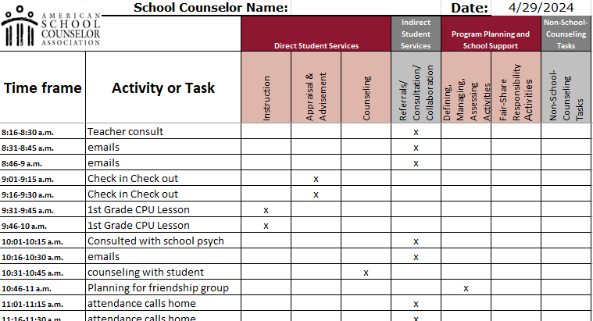
CSCP | Use of Time Calculator
https://www.schoolcounselor.org/getmedia/58cf104d-f75c-4e6a-bff6-4375f145b812/Use-of-Time-5-Day-Calculator.xlsx
20

Slide 21
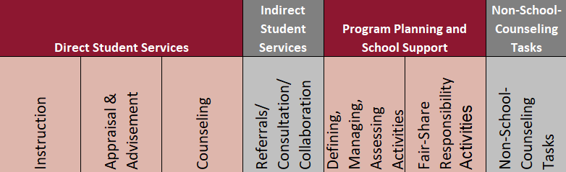
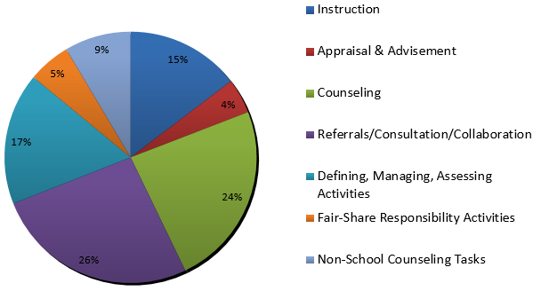
CSCP | Use of Time Calculator Results
21
21

Slide 22
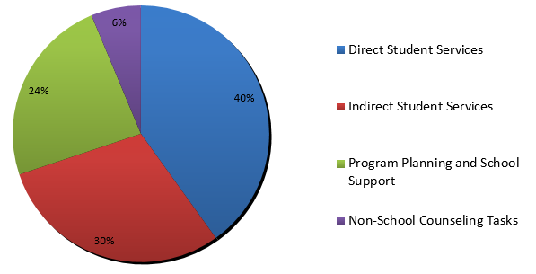
CSCP | Use of Time Calculator Results
FALL SEM
22
22

Slide 23
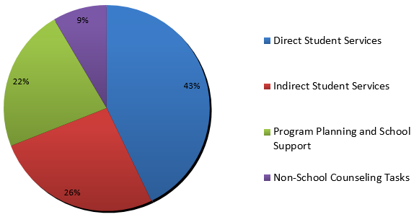
CSCP | Use of Time Calculator Results
SPRING SEM
23
23

Slide 24

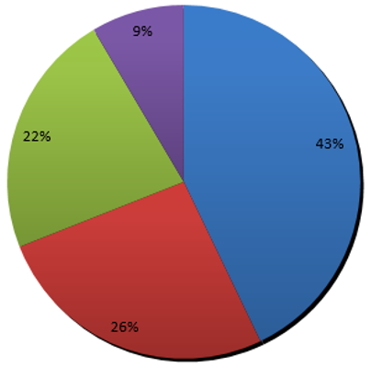
Non-Counseling Duties
Recess Supervision
Assembly Supervision
Discipline Investigation/Support
Escort Student to Class/Health Room
Food/Snack Distribution/Planning
Hallway/Restroom Supervision
Holiday cards/decorations
Interacting w/ Students @ lunch
Lunch Supervision
MTSS Prep
504-related
SBA Proctoring
Office Organization
PBIS Presentation
PBIS Reward Distribution
Small Group Supervision
Staff Meeting
Student Check-In
Student Greeting (a.m.)
Sub for Teacher
Threat Assessment
Travel Time
24
24

Slide 25

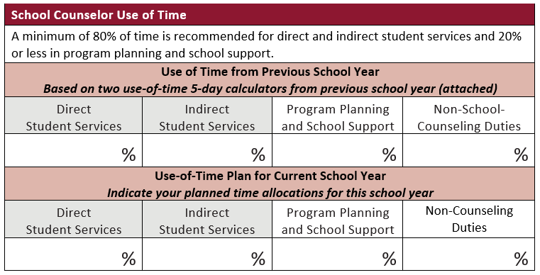
CSCP | Principal Training & Annual Conference
ASCA National Model | 4th Edition - Pg. 60
25
25

Slide 26
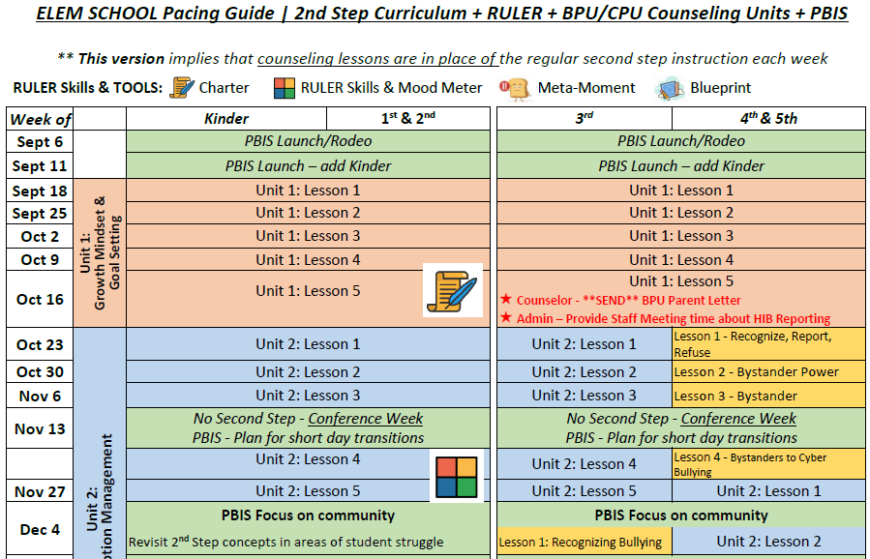
Second Step Pacing Guide Input
26

Slide 27

Second Step Kits
27
27

